Slide 1
New York Motor Vehicle Collisions:
An Exploratory Analysis
DS-GA-1007 Final Project
December 19, 2018
Micaela Flores, Laureano Nisenbaum, Jason Li, Trevor Mitchell

Slide 2
Background & Motivation
Nearly 1.3 million people die in road crashes each year and, on average, there are 3,287 deaths a day due to motor vehicle collisions
Since New York City is the most populous city in the United States, we explored which zip codes in each borough had the most accidents and what caused them
As car accidents are not only responsible for human deaths but material damage as well, this exploratory analysis can advise New York City law enforcement to prioritize their resources to mitigate these accidents
This will help diagnose and remedy the major issues in these high accident-prone zip codes
Notes:
https://github.com/lijason8035/NYCPD/blob/master/NYPDMotorVehicle_v3.ipynb

Slide 3
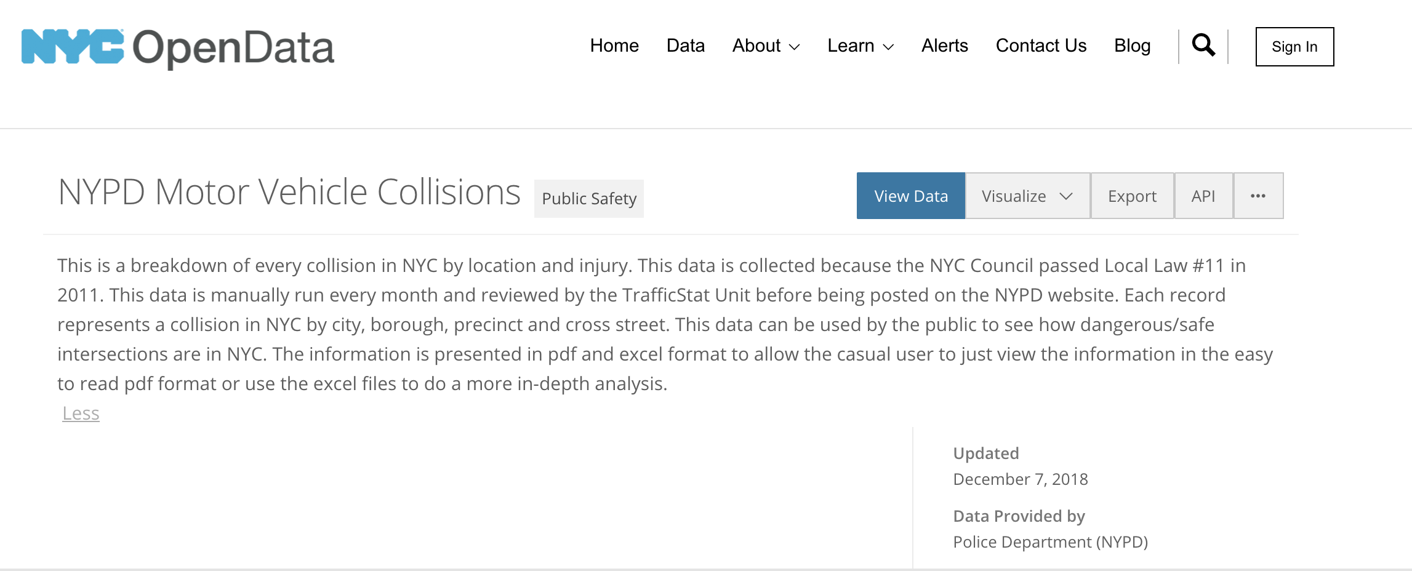
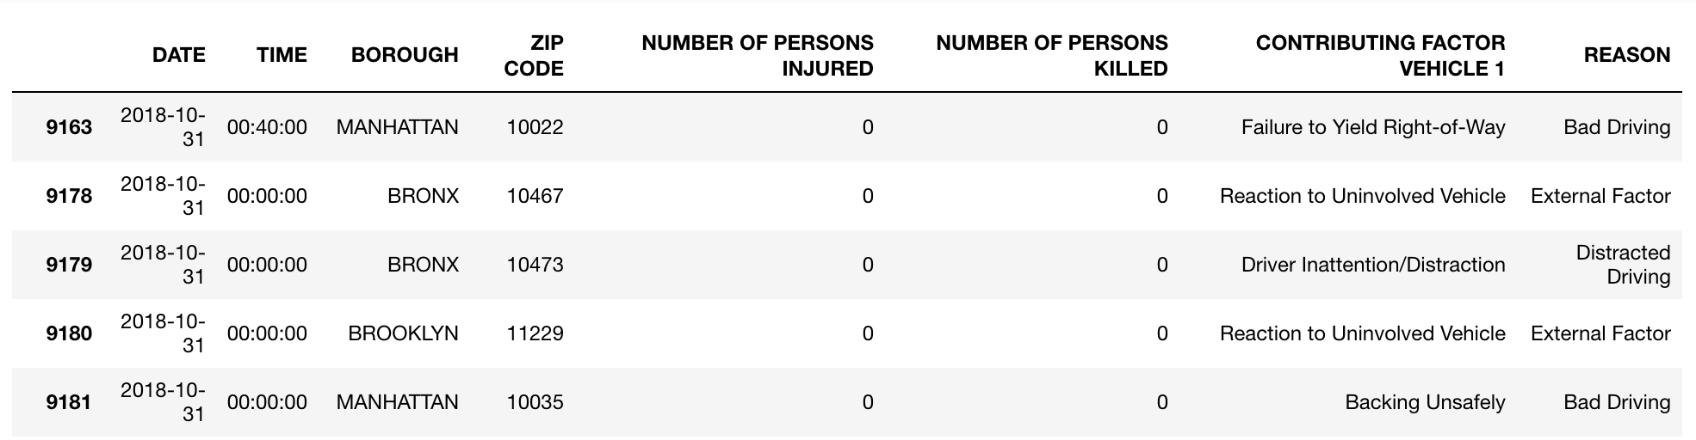
Methodology
Notes:
Excerpt of NYPD Motor Vehicle Collisions Data Set (for space purposes)
Data also includes # of pedestrians killed/injured, # of motorcyclists killed/injured (which Trevor uses later)
Contributing Factor Vehicle 1 has 58 various reasons of why the accident occurred → we sat down as a group and “bucketed” the reasons into broader categories like Bad Driving, Distracted Driving, etc.
This was done using the sklearn preprocessing Label Encoder and mapping the original reasons to the new buckets
This was the data that we used for our exploratory analysis

Slide 4
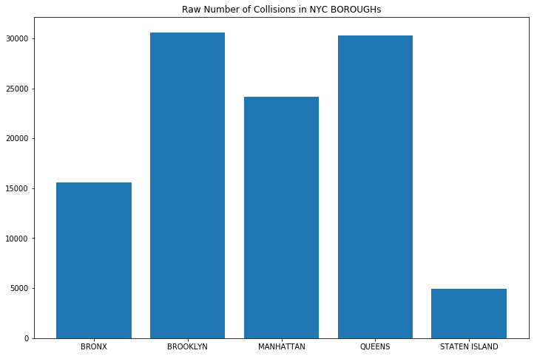
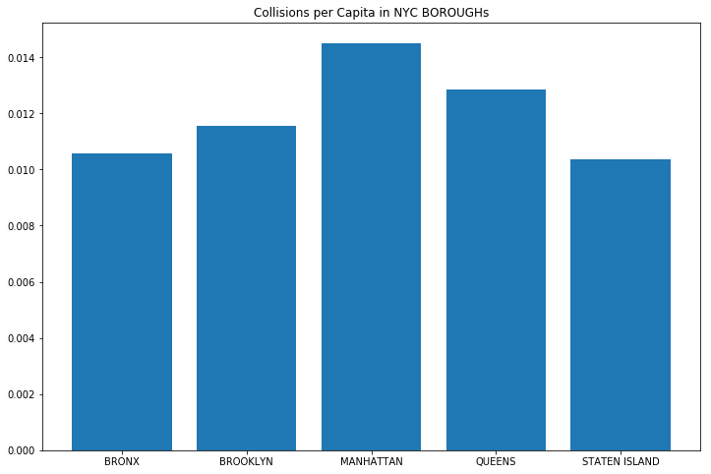
Raw Number of Collisions Vs Collisions per Capita

Slide 5
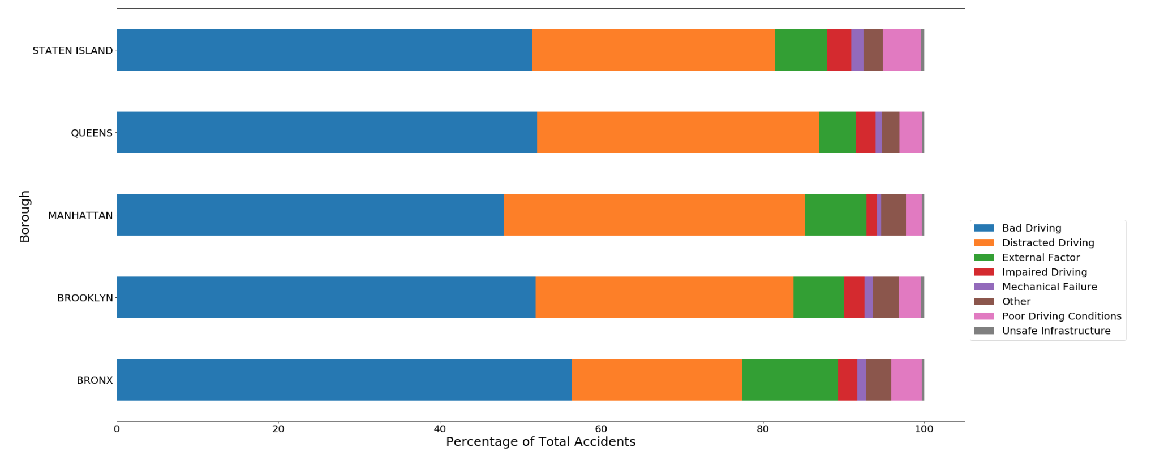
Main Causes of Collisions
Notes:
Talk about how we regrouped the main causes of collisions

Slide 6
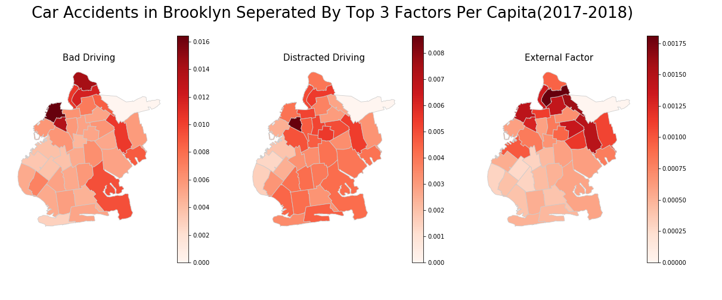
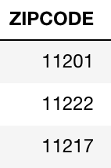
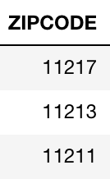
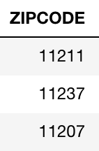
Notes:
Combined demographic zipcode data from nyc open data
Plotted heatmap to give us a better visualization of a comprehensive overview of where the accidents are concentrated in
For comparison sake, we compared each zipcodes within the borough, it is reasonable because we don’t have one zip code that overshadows everything else in the city
Police in each borough would likely care about the districts in their borough: Ex: someone from the 1st precinct would not likely to go to the 109 precinct
Most accidents occurs near the edge of the boroughs
External Factor: drunk pedestrian
Distracted Driving: Driver inattention/distraction

Slide 7
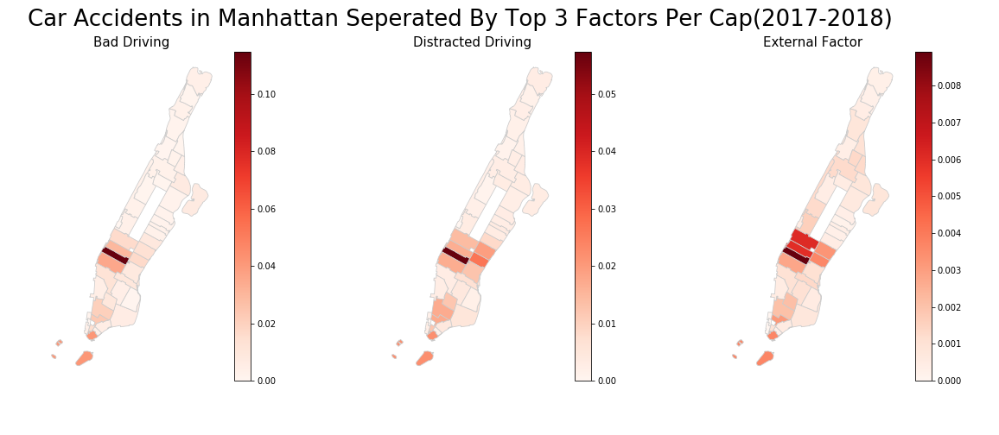
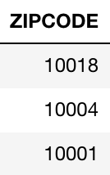
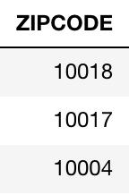
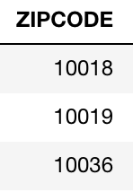

Slide 8
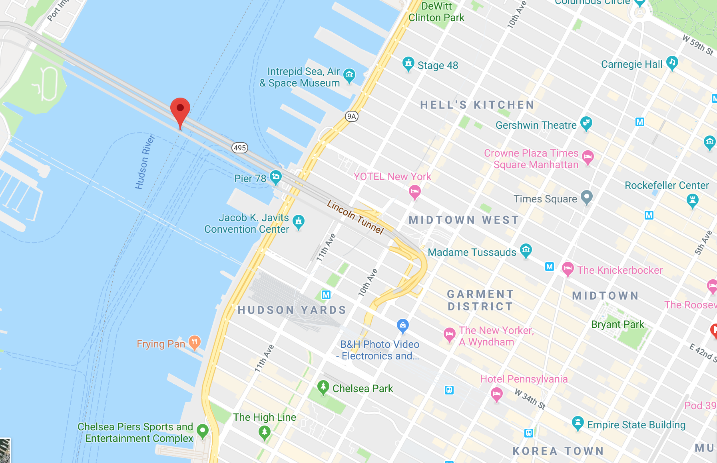

Slide 10
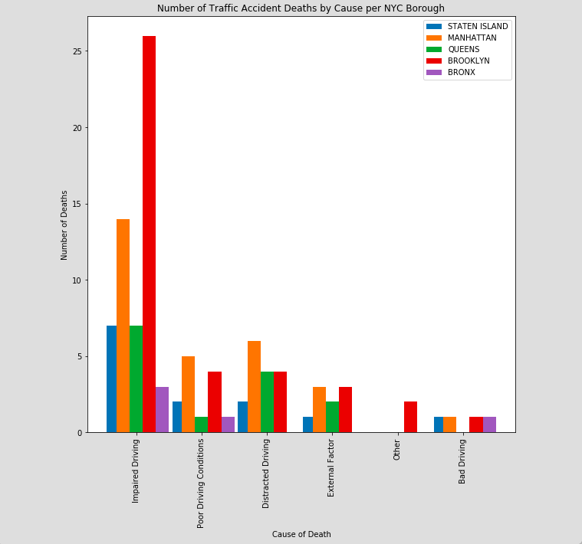
Motor Vehicle Fatalities
Impaired driving is the biggest culprit of motor vehicle fatalities in NYC
Notes:
NOTE: NOT THE FINAL GRAPH TO USE FOR PRESENTATION - MORE COMPREHENSIVE TITLES NEEDED

Slide 11
Conclusion
Recommendations:
NYPD should focus more resources on:
Areas along the border of the boroughs where highways and tunnels are concentrated
Ways to reduce the number of impaired drivers on the road. Ie. Increased police training to identify impaired drivers & disincentives to drive impaired
Future possible work
Include weather data
Consider types of vehicles involved in the collisions (buses, trucks, motorcycles, etc.)
Different approach to data visualization for different borough
Daytime vs Nighttime Analysis

